Slide 1
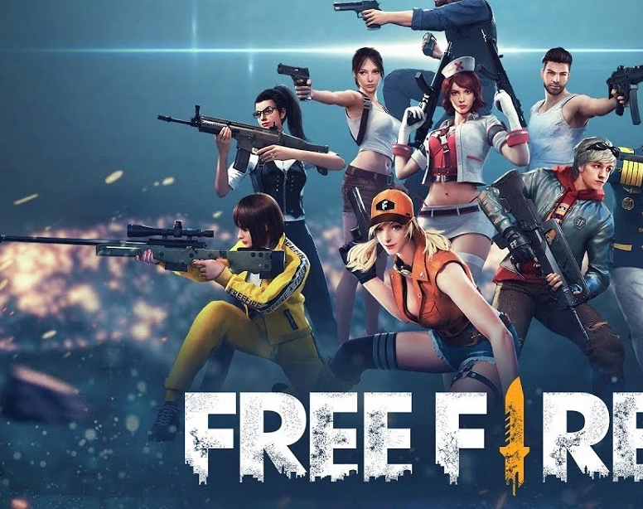
Game development using AI

Slide 2
Outline
Introduction
Problem Statement
Solution
AI integration

Slide 3

INTRODUCTION
Importance of VR and AI in gaming:
Challenges faced in developing a game like Free Fire in VR with AI.
Delve into the methodology employed.
Highlight the benefits of AI integration.

Slide 4

Problem Statement
The problem we aim to address
Limited enemy AI behavior
Lack of personalized player assistance
Limited interaction with non-playable characters (NPCs)
Static and scripted gameplay scenarios
Lack of player-centric matchmaking

Slide 5
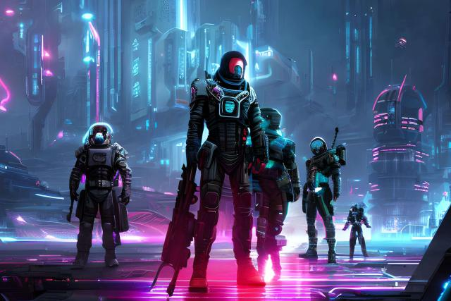
Solution
Developing a Full-Fledged VR Game like Free Fire using AI
Develop a VR game that emulates the core mechanics, setting, and gameplay elements of Free Fire while leveraging AI technology.

Slide 6

Solution for Limited enemy AI behavior
By implementing AI technology, you can create more intelligent and dynamic enemy behavior in the VR game. AI algorithms can enable enemies to exhibit more complex decision-making, adapt their strategies based on player actions, and provide a more realistic and challenging experience

Slide 7

Solution for Lack of personalized player assistance
AI can be used to analyze player behavior, skill level, and performance data. By leveraging machine learning algorithms, the game can provide personalized player assistance, adaptive difficulty levels, and targeted tutorials. AI can offer tips, strategies, and in-game prompts specific to each player's needs, facilitating a smoother learning curve and improving overall player engagement.

Slide 8

Solution for Limited interaction with non-playable characters (NPCs)
AI technology can enhance NPC interactions in the VR game.
NPCs can be programmed with natural language processing capabilities, allowing players to engage in dynamic and meaningful conversations.
NPCs can provide quest lines, offer valuable information or rewards, and create a more interactive and immersive game world.

Slide 9
Solution for Static and scripted gameplay scenarios
By utilizing AI algorithms, the VR game can generate dynamic and procedurally generated gameplay scenarios.
AI can analyze player behavior, map layouts, and available resources to create unique and unpredictable encounters, ensuring that each playthrough feels fresh and engaging.
This can increase replay value and provide players with new challenges and experiences each time they play.

Slide 10
Solution for Lack of player-centric matchmaking
AI-driven matchmaking algorithms can analyze player skill levels, play styles, and preferences to create more balanced and enjoyable matches.
AI can ensure that players are matched with opponents of similar skill levels, promoting fair competition and enhancing the overall multiplayer experience.

Slide 11
METHODOLOGY
Game Design: Define core mechanics, setting, and gameplay elements inspired by Free Fire.
VR Integration: Developing specifically for VR platforms, leveraging motion tracking and room-scale movement.
AI Integration: Implement AI algorithms for realistic enemy behavior and AI-driven player assistance.
Character Prompt Generation: Utilize AI algorithms for dynamic and context-aware character prompts and interactions.
Iterative Development and Testing: Refine gameplay mechanics, AI behavior, and user experience through iterative cycles.
Release and Support: Prepare for distribution, regular updates, community engagement, and technical support

Slide 12

Benefits of AI Integration
Realistic Enemy Behavior: AI algorithms create challenging enemy routines, enhancing gameplay engagement and immersion.
AI-Driven Player Assistance: Adaptive difficulty levels and AI-controlled companions provide assistance tailored to each player's skill level.
Dynamic Character Prompts: AI-generated prompts and interactions enhance immersion and player engagement.

Slide 13
Enemy AI Behavior Algorithm:

